Slide 1

Few-Shot Learning with GNN
Xu Rui
2019 10 15

Slide 2
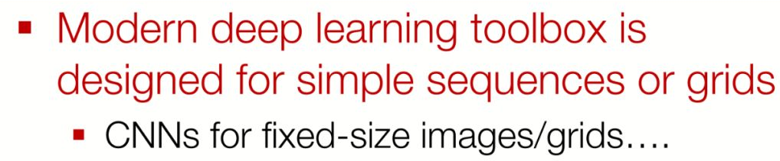
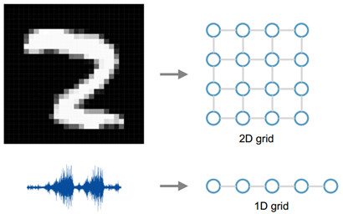
Introduction of GNN
Euclidean data: grids,
sequences…

Slide 3
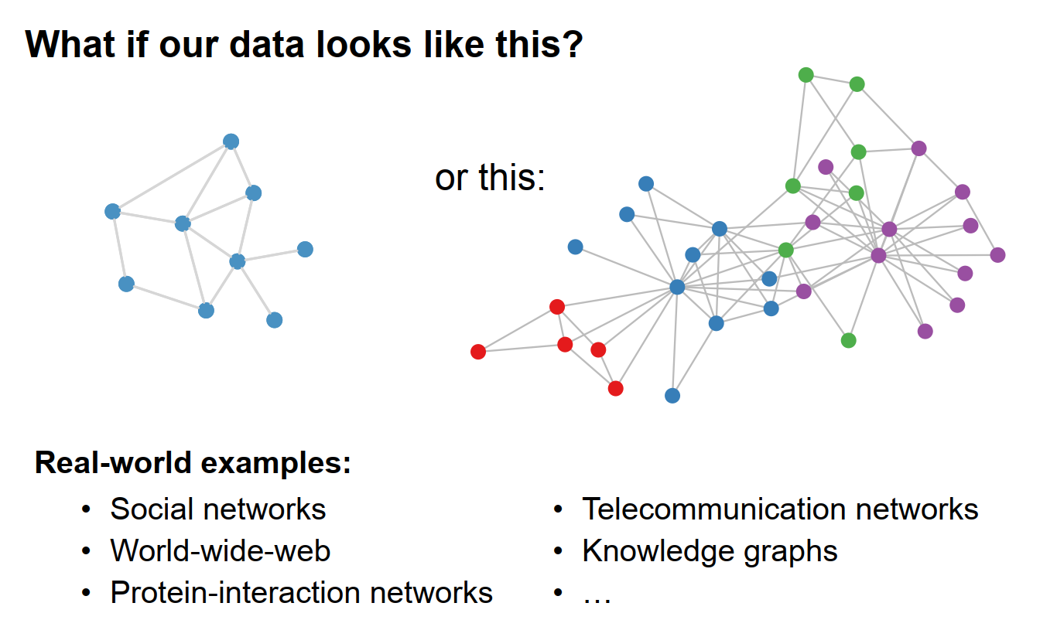
Introduction of GNN
Non-Euclidean Data

Slide 4
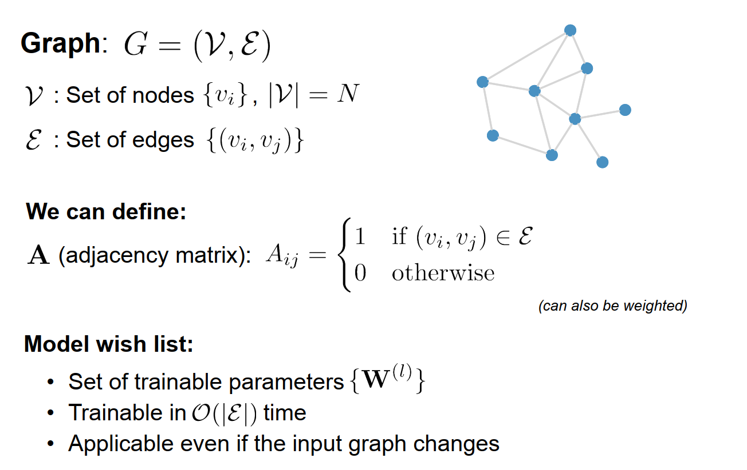
Introduction of GNN
Notes:
图的定义，节点和边。

Slide 5
My Work
ICLR 2018:
Few-Shot Learning with Graph Neural Networks

Slide 6
Motivation
Despite supervised end-to-end achieved big successes, this learning setup does not cover many aspects:
The ability to learn from few examples, i.e., few-shot learning tasks.
The ability to learn from a mixture of labeled and unlabeled examples — semi-supervised learning, i.e., active learning.
Purpose:
To study the problem of few-shot learning with the prism of inference on a partially observed graphical model, constructed from a collection of input images whose label can be either observed or not.
Notes:
由于优化技术的改进、更大的数据集和深度卷积或递归架构的流线型设计，监督端到端学习在计算机视觉、语音或机器翻译任务中取得了极大的成功。尽管取得了这些成功，但这种学习方法并没有涵盖许多方面。
一个这样的例子就是少样本学习任务。
受人类学习湖等人(2015)的启发，研究人员探索了利用相似任务分布的方法，而不是依靠正则化来弥补数据的不足。这定义了一种新的监督学习设置(也称为“元学习”)，其中输入-输出对不再由图像的iid样本及其相关标签给出，而是由图像集合的iid样本及其相关标签相似性给出。

Slide 7

Implement
Task description:
$$𝒯= \left\{\left\{\left(x_{1},l_{1}\right),…\left(x_{s},l_{s}\right)\right\},\left\{{\tilde{x}}_{1},…,{\tilde{x}}_{r}\right\},\left\{{\overline{x}}_{1},…,{\overline{x}}_{t}\right\};l_{i}∈\left\{1,K\right\},x_{i},{\tilde{x}}_{j},{\overline{x}}_{j}\sim 𝒫_{l}\left(ℝ^{N}\right)\right\}$$
$$\text{and} Y=(y_{1},…,y_{t})∈{\left\{1,K\right\}}^{t}$$
for arbitrary values of s; r; t and K. Where s is the number of labeled samples, r is the number of unlabeled samples (r > 0 for the semi-supervised and active learning scenarios) and t is the number of samples to classify. K is the number of classes.
Few-Shot Learning
When r = 0, t = 1 and s = qK, there is a single image in the collection with unknown label. If moreover each label appears exactly q times, this setting is referred as the q-shot, K-way learning.
Notes:
s:标签样本数，r:无标签样本数，t：要分类的样本数；K:类的个数

Slide 8
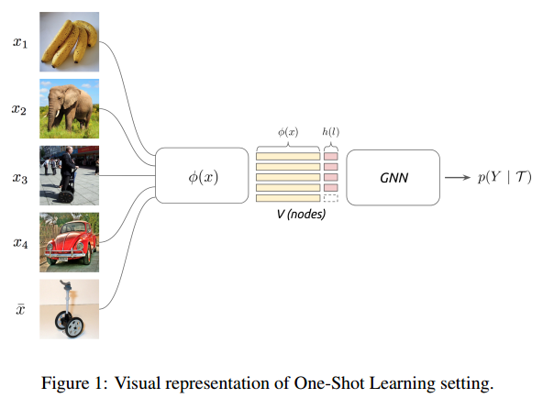
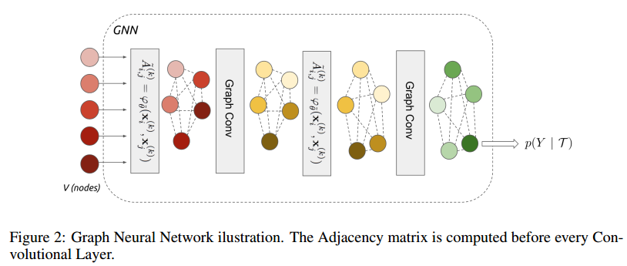
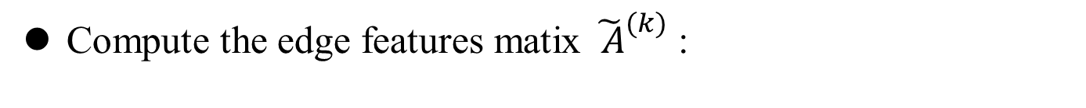

Implement
Compute the edge features matix ${\tilde{ A}}_{}^{(k)}$:
$${\tilde{A}}_{i,j}^{(k)}=φ_{\tilde{θ}}(x_{i}^{(k)},x_{j}^{(k)})$$
$$φ_{\tilde{θ}}(x_{i}^{(k)},x_{j}^{(k)})={MLP}_{\tilde{θ}}(abs(x_{i}^{(k)}−x_{j}^{(k)}))$$
Notes:
利用现有节点的隐藏特征构造A矩阵，具体方法是计算节点之间的相似性，得到节点两两之间的邻接矩阵。对两节点求差的绝对值后进入一个多层感知器得到A matrix。

Slide 9

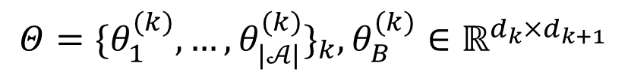
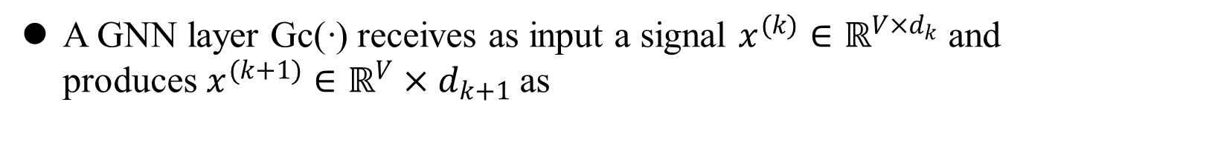
Implement
A GNN layer Gc(·) receives as input a signal $x^{(k)}∈ℝ^{V×d_{k}}$and produces $x^{(k+1)}∈ℝ^{V}×d_{k+1}$as
$$x_{l}^{(k+1)}=\text{Gc}(x^{(k)})=ρ(\sum_{B∈𝒜}{B}x^{(k)}θ_{B,l}^{(k)}),l=d_{1}…d_{k+1}$$
$$Θ={\{θ_{1}^{(k)},…,θ_{|𝒜|}^{(k)}\}}_{k},θ_{B}^{(k)}∈ℝ^{d_{k}×d_{k+1}}$$
, are trainable parameters
where
Notes:
利用GNN相关知识，以每个节点的邻居节点的表示和自己当前的表示来更新下一步的表示
B是上面求的邻接关系矩阵A。

Slide 10
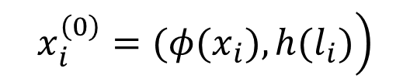
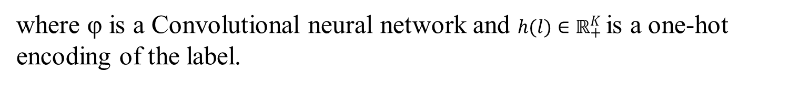
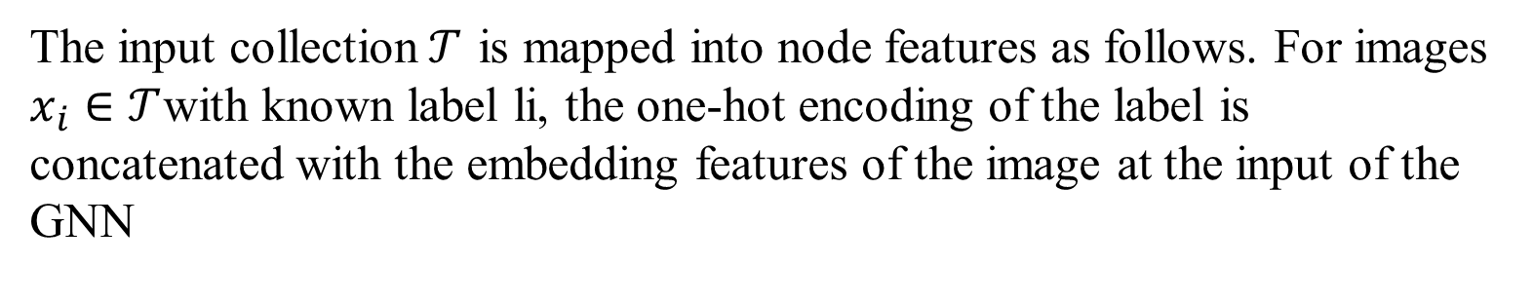
Implement
Construction of Initial Node Features
The input collection$𝒯$ is mapped into node features as follows. For images $x_{i}∈𝒯$with known label li, the one-hot encoding of the label is concatenated with the embedding features of the image at the input of the GNN
$$\left.x_{i}^{\left(0\right)}=(φ(x_{i}),h(l_{i})\right)$$
where φ is a Convolutional neural network and $h(l)∈ℝ_{+}^{K}$is a one-hot encoding of the label.
Notes:
初始化方式为：利用CNN得到的图片的向量表示，以及样本的label的onehot表示拼接得到每个节点的表示。对于半监督的情形，未标注样本的label的onehot表示是随机生成的。
输入集合T被映射到节点特性，如下所示。对于已知标签li的图像xi 2 T，将标签的一次热编码与图像在GNN输入处的嵌入特征连接起来。

Slide 11
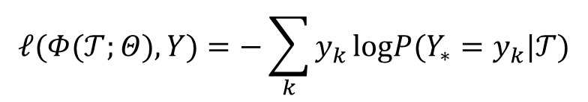
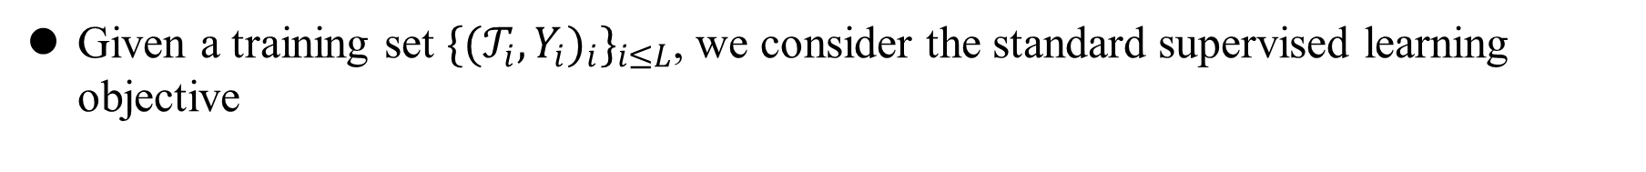
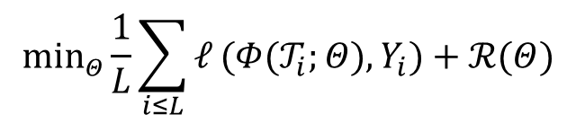
Implement
We then consider the Cross-entropy loss evaluated at node ∗:
$$𝓁(Φ(𝒯;Θ),Y)=−\sum_{k}{y_{k}}logP(Y_{∗}=y_{k}|𝒯)$$
Given a training set ${\{{(𝒯_{i},Y_{i})}_{i}\}}_{i≤L}$, we consider the standard supervised learning objective
$$\min_{Θ}\frac{1}{L}\sum_{i≤L}{𝓁}(Φ(𝒯_{i};Θ),Y_{i})+ℛ(Θ)$$
Notes:
标准监督学习下的目标函数，R为标准正则化项。输出与Query 样本的label求loss，进行反向传播，训练。

Slide 12
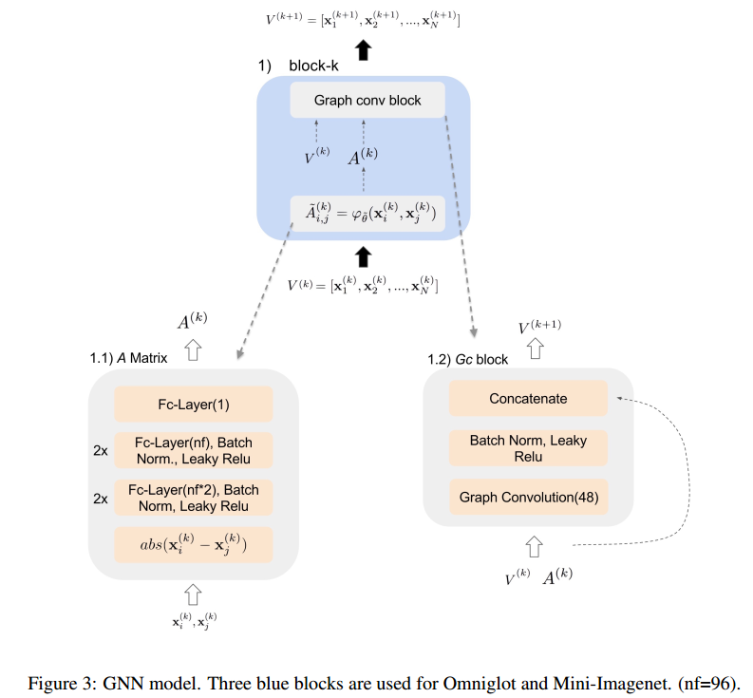
Implement

Slide 13
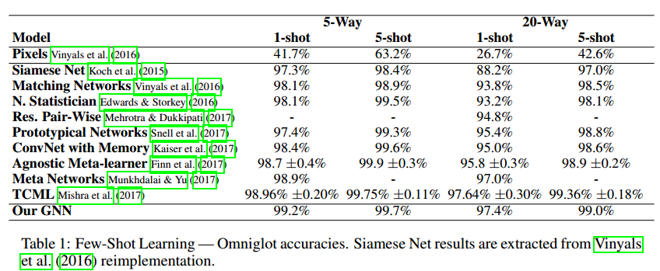
Results

Slide 14
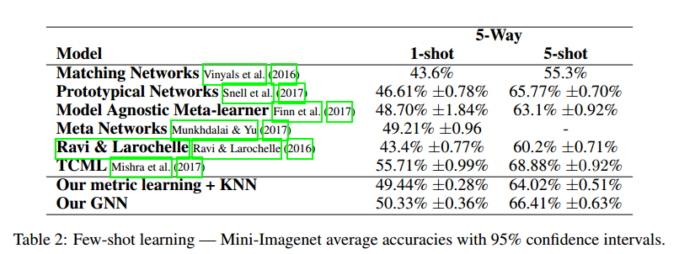
Results

Slide 15

Reference:
[1] Gregory Koch, Richard Zemel, and Ruslan Salakhutdinov. “Siamese neural networks for one-shot image recognition.” ICML Deep Learning Workshop. 2015.
[2] Oriol Vinyals, et al. “Matching networks for one shot learning.” NIPS. 2016.
[3] Jake Snell, Kevin Swersky ,.Richard S. Zemel . “ Prototypical Networks for Few-shot Learning ” arXiv:1703.05175v2 [cs.LG] 19 Jun 2017
[4] Joaquin Vanschoren. “ Meta-Learning: A Survey ” Eindhoven University of Technology, arXiv:1810.03548v1 [cs.LG] 8 Oct 2018

Slide 16
THANK YOU

